Slide 1
Year 11 Exams - Expectations of Excellence

Slide 2
YEAR 11 EXAMS
All exams, including mock exams, will take place under formal exam conditions - there will be external invigilators controlling the exams and all normal procedures will be followed. You will have been issued with a personalised timetable listing the dates, times, and locations for each of your exams including your seat number. Read your timetable carefully – being in the right place at the right time is your responsibility!

Slide 3
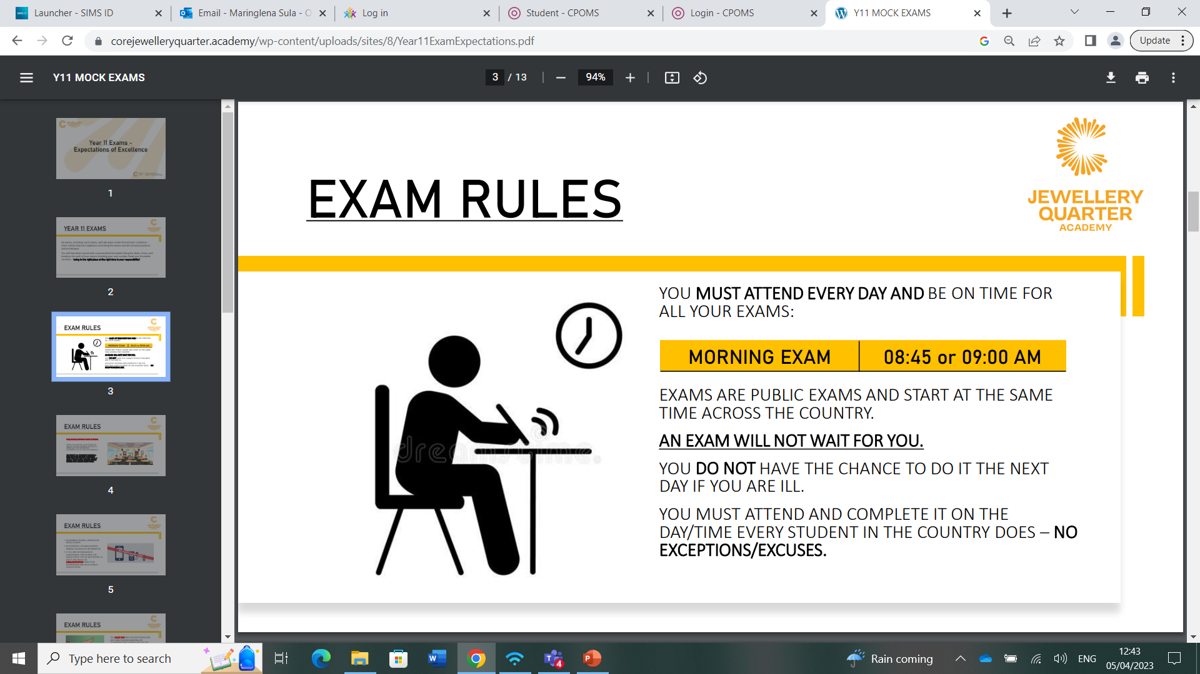
EXAM RULES

Slide 4
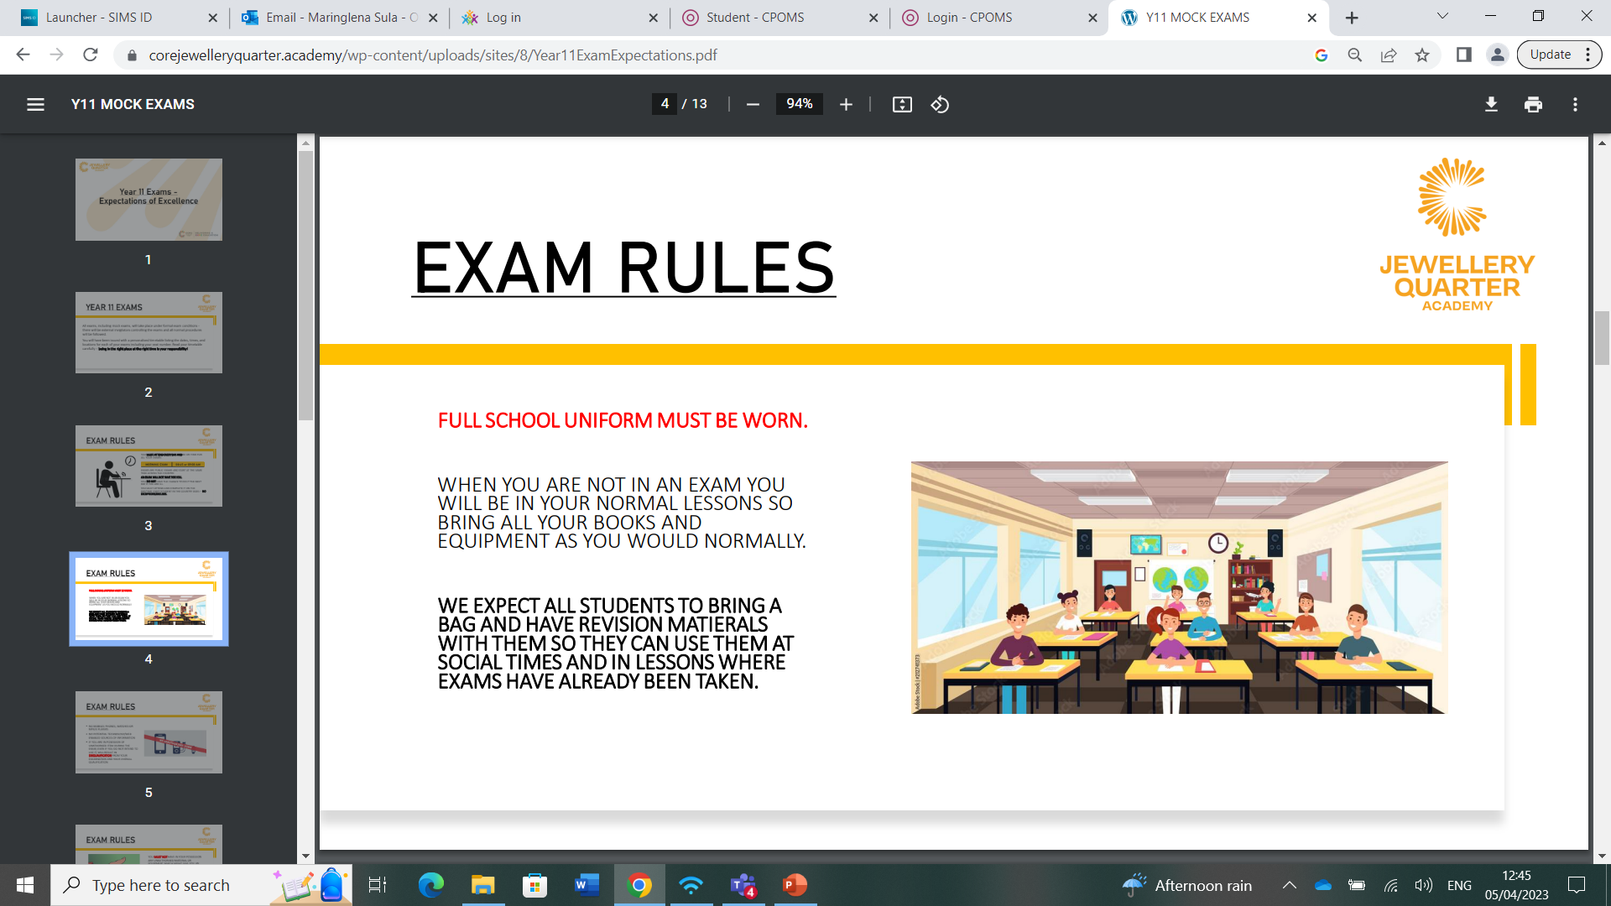
EXAM RULES
FULL SCHOOL UNIFORM MUST BE WORN.
WHEN YOU ARE NOT IN AN EXAM YOU WILL BE IN YOUR NORMAL LESSONS SO BRING ALL YOUR BOOKS AND EQUIPMENT AS YOU WOULD NORMALLY. WE EXPECT ALL STUDENTS TO BRING A BAG AND HAVE REVISION MATIERALS WITH THEM SO THEY CAN USE THEM AT SOCIAL TIMES AND IN LESSONS WHERE EXAMS HAVE ALREADY BEEN TAKEN.

Slide 5
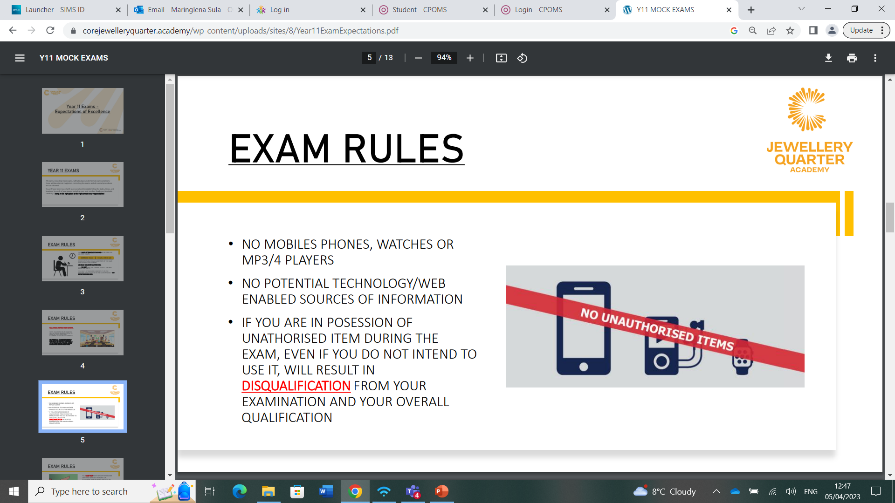
EXAM RULES
NO MOBILES PHONES, WATCHES OR MP3/4 PLAYERS
• NO POTENTIAL TECHNOLOGY/WEB ENABLED SOURCES OF INFORMATION
•IF YOU ARE IN POSESSION OF UNATHORISED ITEM DURING THE EXAM, EVEN IF YOU DO NOT INTEND TO USE IT, WILL RESULT IN DISQUALIFICATION FROM YOUR EXAMINATION AND YOUR OVERALL QUALIFICATION

Slide 6
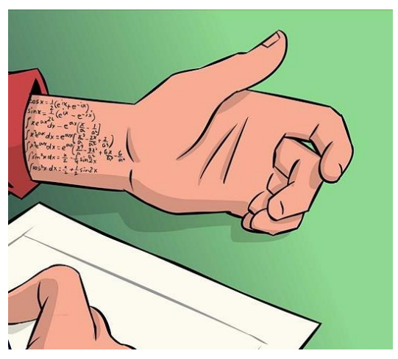
EXAM RULES
YOU MUST NOT HAVE IN YOUR POSSESSION ANY UNAUTHORISED MATERIAL OR EQUIPMENT WHICH MIGHT GIVE YOU AN UNFAIR ADVANTAGE. IF YOU ARE IN POSESSION OF UNATHORISED MATERIAL OR EQUIPTMENT DURING THE EXAM, EVEN IF YOU DO NOT INTEND TO USE IT, WILL RESULT IN DISQUALIFICATION.
PLEASE MAKE SURE YOU LEAVE ANY NOTES IN YOUR BAG BEFORE YOU ENTER THE EXAM ROOM!!

Slide 7
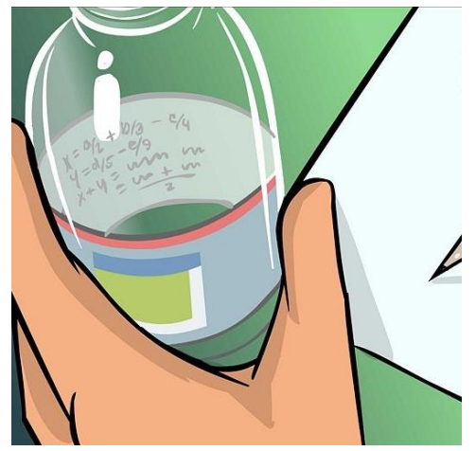
EXAM RULES
ONLY WATER BOTTLES WILL BE PERMITTED INTO THE EXAMINATION ROOM AND MUST HAVE THE LABEL REMOVED PRIOR TO ENTERING. ANY BOTTLES CONTAINING ANYTHING OTHER THAN WATER OR WITH LABELS ON WILL BE TAKEN AWAY FROM YOU.
NO FOOD/CHEWING GUM IS TO BE CONSUMED DURING AN EXAM.

Slide 8
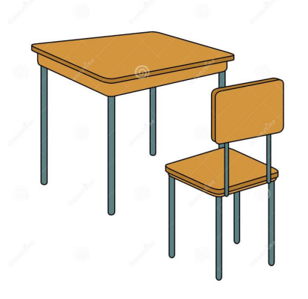
EXAM RULES
YOU MUST FOLLOW THE SEATING PLAN AND ENSURE YOU ARE SAT IN THE CORRECT SEAT ACCORDING TO THE PLAN PUBLISHED OUTSIDE THE EXAM ROOM.
YOU MUST WEAR YOUR LANYARD WITH YOUR ID BADGE

Slide 9
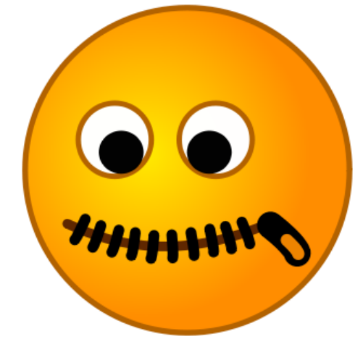
EXAM RULES
THERE MUST BE TOTAL SILENCE AT ALL TIMES IN THE EXAMINATION ROOM.
YOU MUST NOT TALK TO, ATTEMPT TO COMMUNICATE WITH OR DISTURB OTHER CANDIDATES ONCE YOU HAVE ENTERED THE EXAMINATION ROOM.
YOU ARE RISKING DISQUALIFICATION FROM EVERY PUBLIC EXAMINATION CONDUCTED BY THE BOARD IF YOU ARE NOT SILENT.

Slide 10
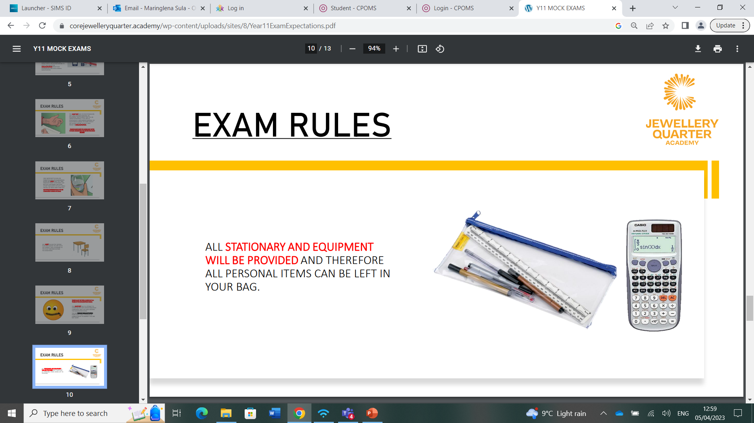
EXAM RULES
ALL STATIONARY AND EQUIPMENT WILL BE PROVIDED AND THEREFORE ALL PERSONAL ITEMS CAN BE LEFT IN YOUR BAG.

Slide 11
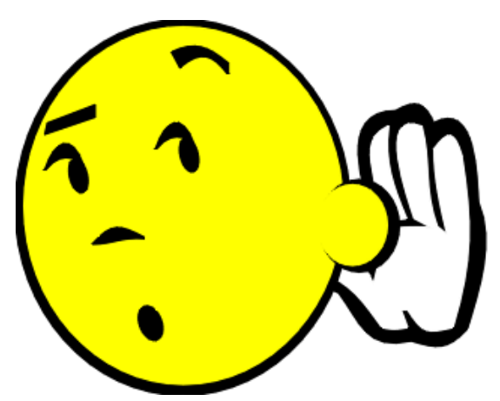
EXAM RULES
YOU MUST FOLLOW THE INSTRUCTIONS OF THE INVIGILATOR AT ALL TIMES, FAILURE TO DO SO COULD LEAD TO DISQUALIFICATION.
IF YOU NEED AN INVIGILATORS ATTENTION AT ANY POINT IN THE EXAM, RAISE YOUR HAND AND WAIT QUIETLY.
WHEN THE INVIGILATOR TELLS YOU TO STOP WRITING YOU MUST DO SO STRAIGHT AWAY. YOU MUST NOT ATTEMPT TO FINISH A QUESTION OR A SENTENCE AND SHOULD IMMEDIATELY CLOSE YOUR ANSWER BOOKLET.

Slide 12
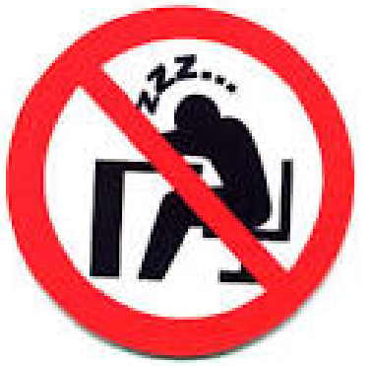
EXAM EXPECTATIONS – 100%
WE EXPECT YOU TO USE ALL OF THE ALLOCATED TIME TO PRODUCE YOUR BEST WORK. CHECK, CHECK AGAIN AND ADD TO SQUEEZE THE MOST MARKS OUT OF EACH PAPER.
STUDENTS SHOULD NOT ‘FINISH EARLY’ AND WE GIVE 100% IN EACH PAPER.

Slide 13
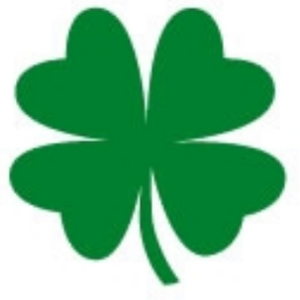
GOOD LUCK FROM TEAM ROCKWOOD!
WE WISH YOU EVERY SUCCESS AND LOOK FORWARD TO SEEING YOU SMILING AND HAPPY IN AUGUST WHEN YOU COLLECT THE RESULTS!

